Slide 1
yaSpMV: Yet Another SpMV Framework on GPUs
Shengen Yan
论文分享：向春阳
分享时间：20210825

Slide 2
目录
引入
1
v
论文介绍
2
论文结果
3
论文总结
4

Slide 3
简介
稀疏矩阵不存储零元，只存储非零元和它们的位置
应用领域
线性方程组求解：直接求解法（高斯消元法）和迭代求解法（ Jacobi、SOR、Gauss-Seidel等），基础操作是矩阵向量乘法
名词解释
非零元数：稀疏矩阵中除0以外的元素个数
平均每行非零元数：非零元数/row
矩阵填充率：非零元占整个矩阵的比率
稀疏模式：非零元的分布方式，不同稀疏模式需要使用不同的存储格式
行带宽：对于非零元数不为0的任意行，相邻非0元素的最大距离（从列号看）
3

Slide 4
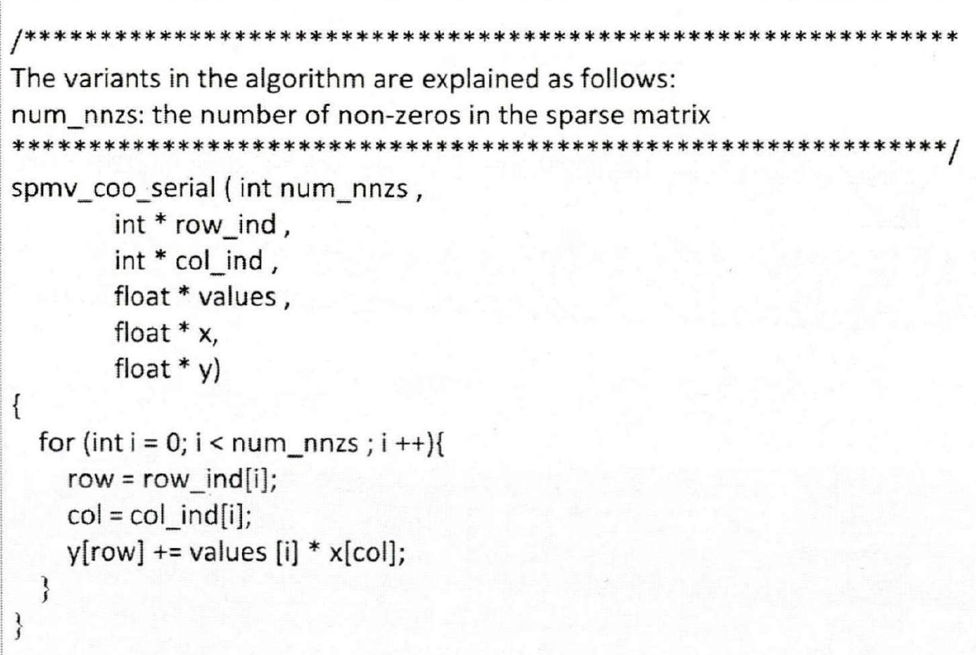
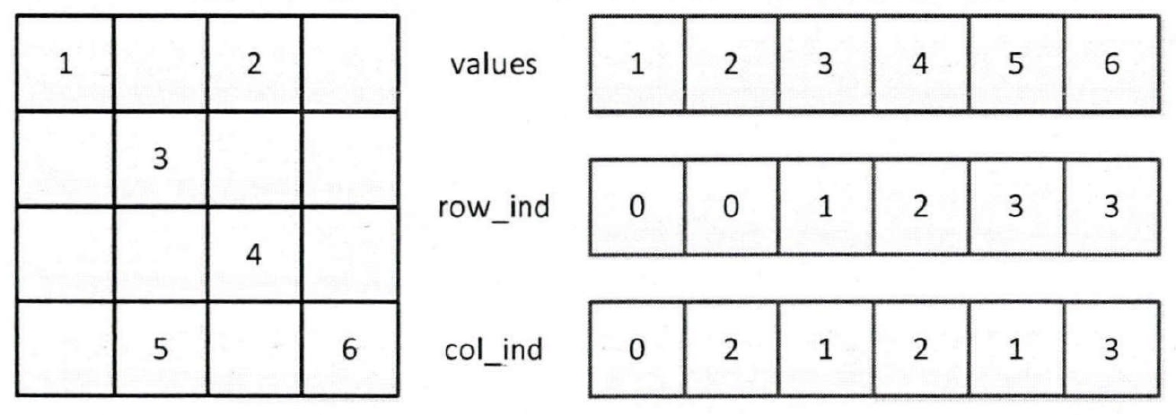
存储格式
基本存储格式：COO、 CSR、DIA、ELL
基于分块格式：BCSR、BDIA、BELL、CSX
基于矩阵重排格式：SELL、SBELL
混合模式：HYB、Cocktail
COO格式
(coordinate format)
values/row_ind/col_ind访问连续
X访问非规则，Y访问非规则
优点：转换成其它存储格式很快捷简便
缺点：空间占用大
4

Slide 5
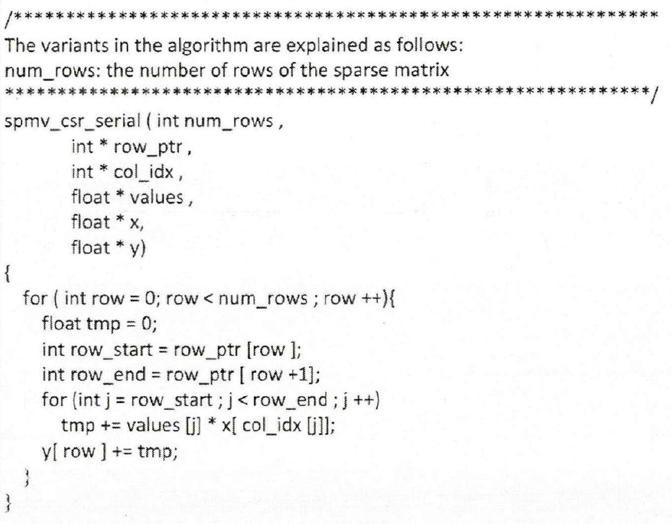
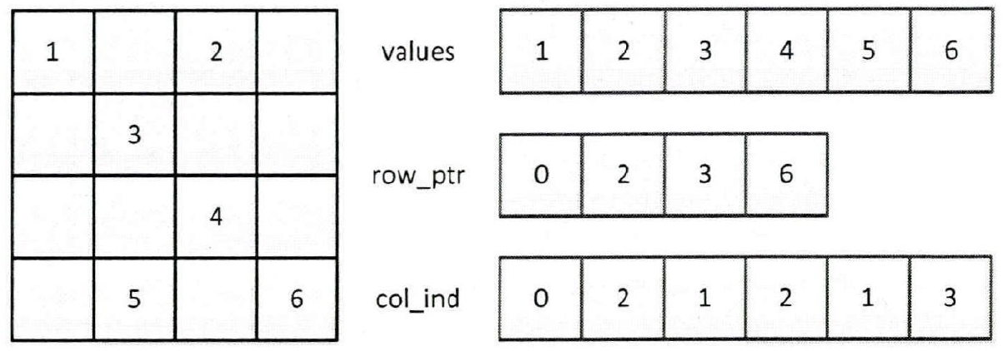
CSR格式
(Compressed sparsed row format)
4
6
row_ptr数组的长度为稀疏矩阵行数row+1，存储的是每行的开始即每行第一个非零元的位置，最后一个元素表示非零元总数。
values/row_ptr/col_ind访问连续，X和Y访问不连续
优点：节省存储空间，可以有效表示任何格式
缺点：对X/Y的访问不规则
5

Slide 6
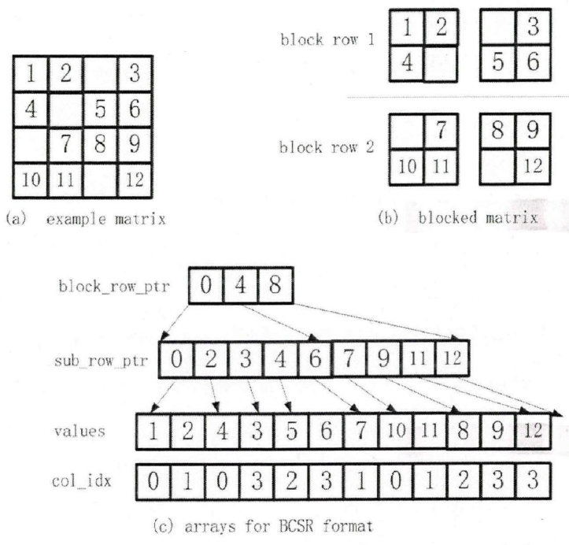
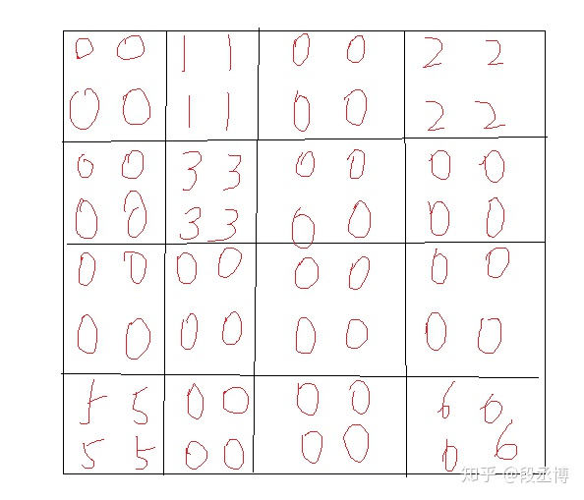
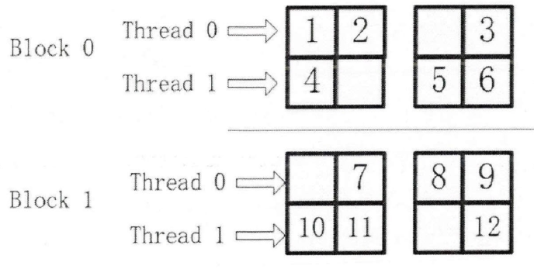
BSR格式
(Block sparsed row format)
矩阵可以均匀分块，M % R = 0 和 N % C = 0
而非零矩阵元处于某些块，按照CSR的方式压缩
存储的不再是某个矩阵元，而是矩阵的一个子块。
sub_row_ptr指向子块中每行的起始位置
block_row_ptr指向每一个子块行的开始
如果子块对应X的部分能够全部放入到GPU的缓存中，X将得到充分的重用。
BSR相较于CSR缺点是更多的数组指针，带来额外的存储空间和存储器访问。
6

Slide 7
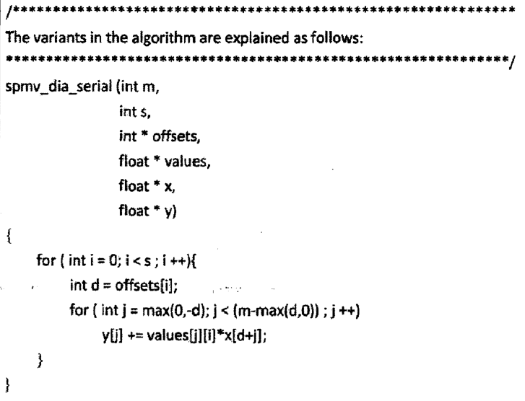
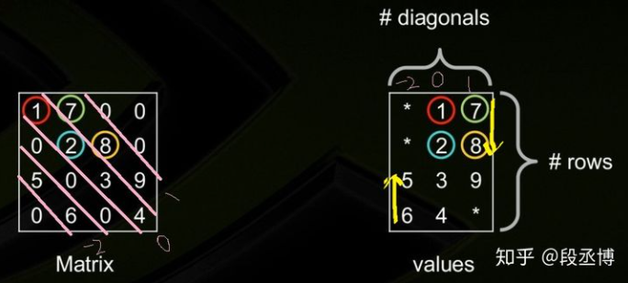
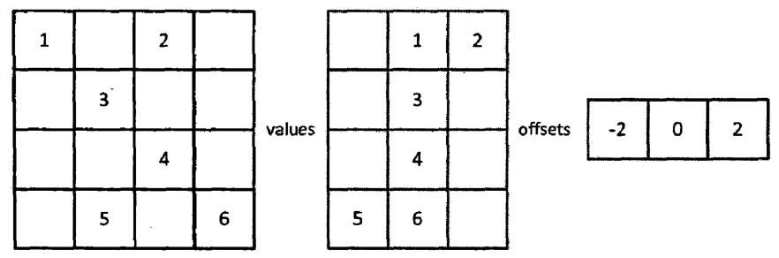
DIA格式
(the diagonal sparse matrix format)
用DIA格式存储稀疏矩阵，没有间接访问。适合具有对角线特征的稀疏矩阵。当非零元素没有全部分布在对角线上时，通过矩阵分解为对角矩阵和非对角矩阵。
values=m x s，其中m=row, s为主对角线不全为0的条数。
offset对应于values的每列，表示相对主对角线位置
7

Slide 8
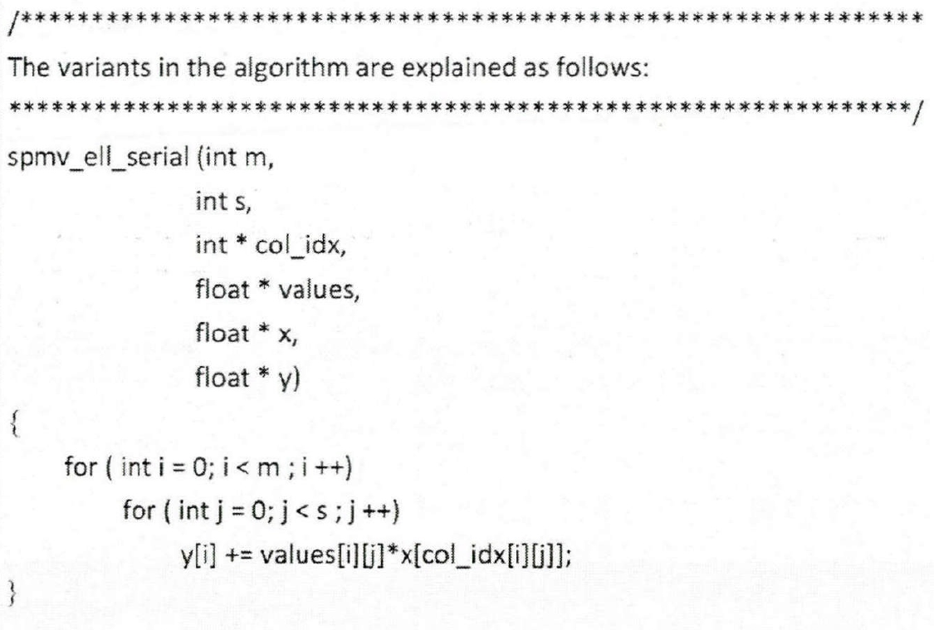
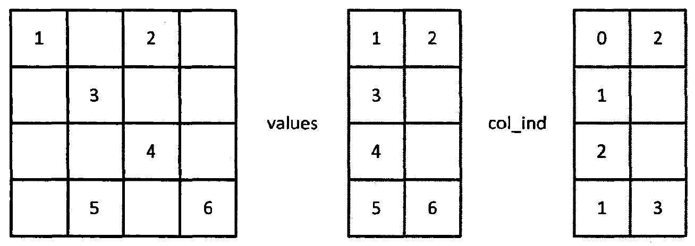
ELL格式
(the format used by ELLPACK and ITPACK)
将稀疏矩阵采用稠密形式存储，更适合并行计算
稠密矩阵mxs，其中m=rows, s=行最多非0元个数
只有两个数组就存储一个稀疏矩阵，节省存储空间
适合各行非零元数基本一致的稀疏矩阵。ELL更适合众核结构并行
优势：适合各行非零元数基本一致的稀疏矩阵
8

Slide 9
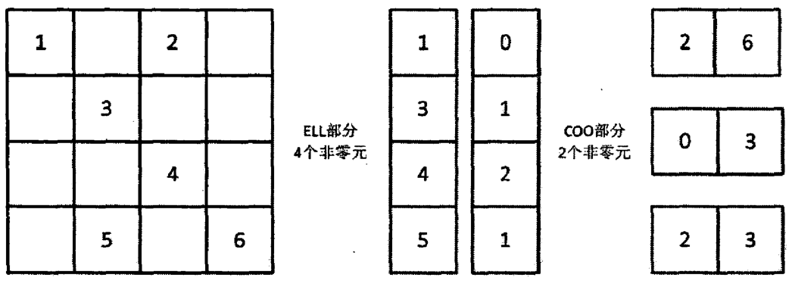
HYB格式
(hybrid format)
value
row
col
一种专门针对众核GPU提出的混合格式，弥补ELL格式只适合各行非零元数相差不大的缺点。
根据阈值K将矩阵分为ELL格式和COO格式存储。每行非零元素小于等于K的部分存为ELL格式，大于K部分存为COO格式
算法将ELL格式和COO格式各运行一次
9

Slide 10
优化难点
1 非规则访存：存在大量间接访问，数据重用率低，大量非连续访存和动态访存。
2 负载平衡：稀疏矩阵非零元分布不均匀，造成线程间负载不均衡
3 计算访存比大：稀疏矩阵存储格式决定了访存需求大
10

Slide 11
目录
引入
1
v
论文介绍
2
论文结果
3
论文总结
4

Slide 12
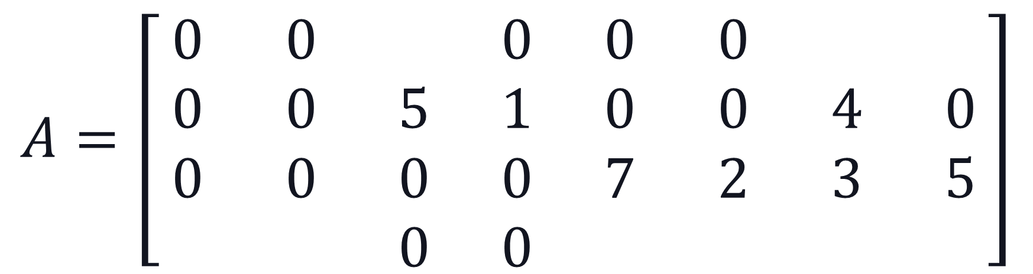
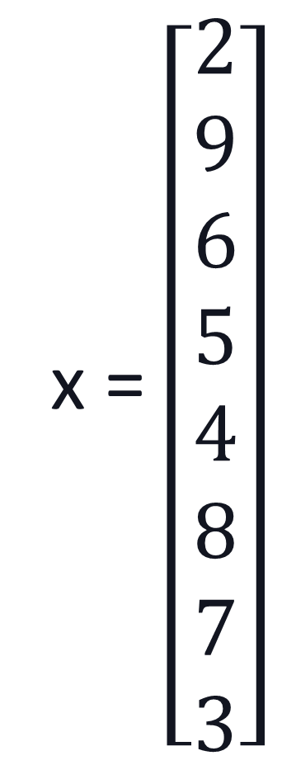
Parallel implementation: two challenges
Bandwidth
the matrix data and the corresponding index data have low reuse
Load imbalance
Different number of non-zeroes in different rows
Worse on GPUs
x = $\left[\begin{matrix}2 \\ 9 \\ 6 \\ 5 \\ 4 \\ 8 \\ 7 \\ 3\end{matrix}\right]$
$$A=\left[\begin{matrix}0 & 0 & & 0 & 0 & 0 & & \\ 0 & 0 & 5 & 1 & 0 & 0 & 4 & 0 \\ 0 & 0 & 0 & 0 & 7 & 2 & 3 & 5 \\ & & 0 & 0 & & & & \end{matrix}\right]$$
3 6 9
4 7 1 3 8 4

Slide 13
BCCOO format
addressing the bandwidth challenge
BCCOO+ format
improve the cache hit rate
Customized efficient segmented scan/sum
addressing load imbalance problem
Efficiency
Auto-Tuning Framework
Explore optimization parameters for different sparse matrices and platforms

Slide 14
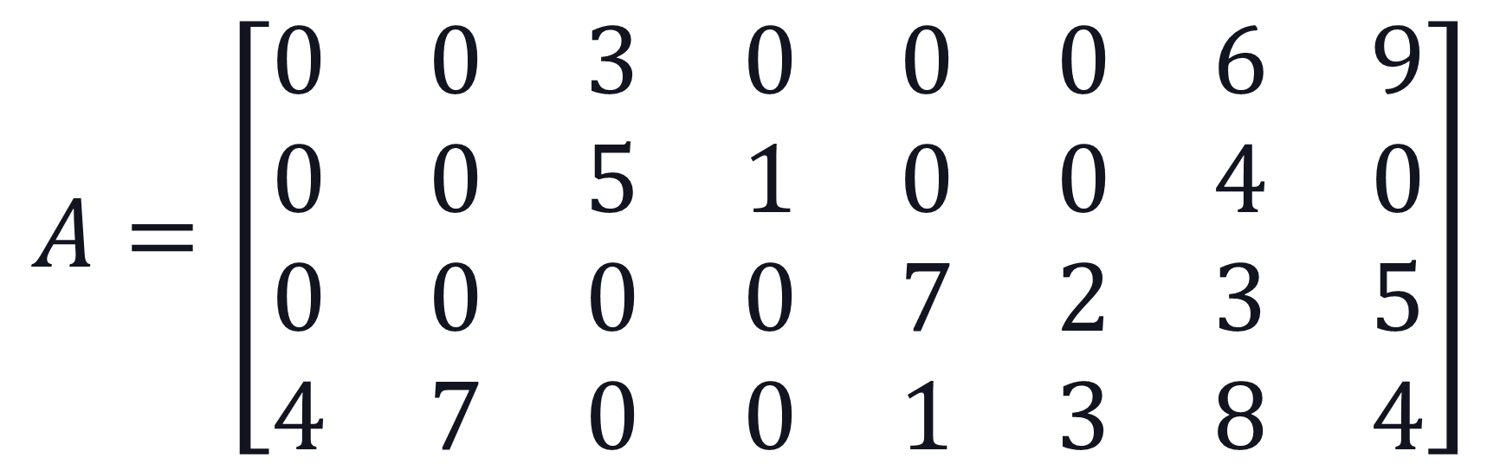
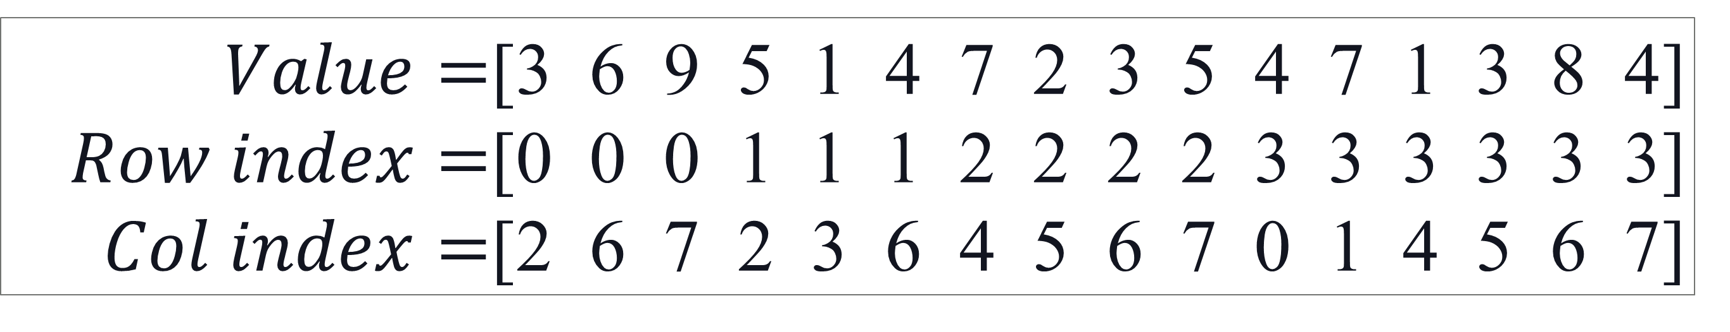
COO format
$$A=\left[\begin{matrix}0 & 0 & 3 & 0 & 0 & 0 & 6 & 9 \\ 0 & 0 & 5 & 1 & 0 & 0 & 4 & 0 \\ 0 & 0 & 0 & 0 & 7 & 2 & 3 & 5 \\ 4 & 7 & 0 & 0 & 1 & 3 & 8 & 4\end{matrix}\right]$$
$Value=$[3 6 9 5 1 4 7 2 3 5 4 7 1 3 8 4]
$Row index=$[0 0 0 1 1 1 2 2 2 2 3 3 3 3 3 3]
$Col index=$[2 6 7 2 3 6 4 5 6 7 0 1 4 5 6 7]
COO format of matrix A

Slide 15
1. Blocked COO (BCOO) format
$$A=\left[\begin{matrix}0 & 0 & 3 & 0 & 0 & 0 & 6 & 9 \\ 0 & 0 & 5 & 1 & 0 & 0 & 4 & 0 \\ 0 & 0 & 0 & 0 & 7 & 2 & 3 & 5 \\ 4 & 7 & 0 & 0 & 1 & 3 & 8 & 4\end{matrix}\right]$$

Slide 16
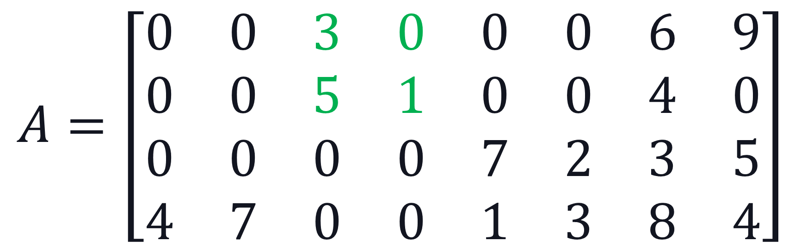

1. Blocked COO (BCOO) format
$$A=\left[\begin{matrix}0 & 0 & 3 & 0 & 0 & 0 & 6 & 9 \\ 0 & 0 & 5 & 1 & 0 & 0 & 4 & 0 \\ 0 & 0 & 0 & 0 & 7 & 2 & 3 & 5 \\ 4 & 7 & 0 & 0 & 1 & 3 & 8 & 4\end{matrix}\right]$$
$$Value=\left\{\begin{aligned}[ ] \\ [ ]\end{aligned}\right\}$$
$Blocked Row index=$[ ]$Blocked Col index=$[ ]
0
5 1
0
1
BCOO format block size 2x2

Slide 17
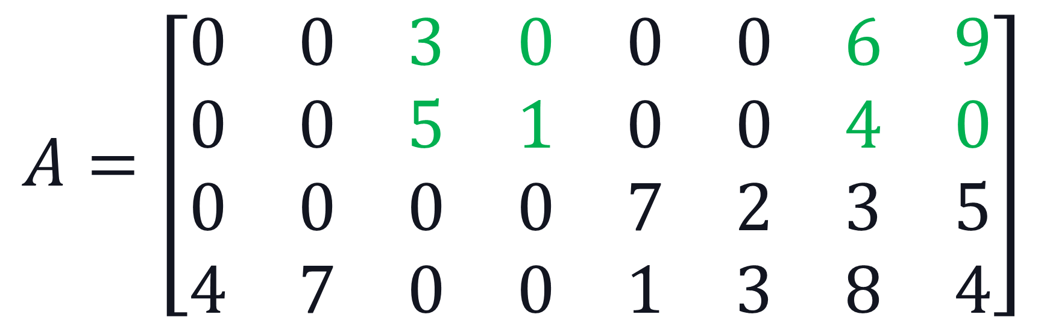

1. Blocked COO (BCOO) format
$$A=\left[\begin{matrix}0 & 0 & 3 & 0 & 0 & 0 & 6 & 9 \\ 0 & 0 & 5 & 1 & 0 & 0 & 4 & 0 \\ 0 & 0 & 0 & 0 & 7 & 2 & 3 & 5 \\ 4 & 7 & 0 & 0 & 1 & 3 & 8 & 4\end{matrix}\right]$$
$$Value=\left\{\begin{aligned}[ ] \\ [ ]\end{aligned}\right\}$$
$Blocked Row index=$[ ]$Blocked Col index=$[ ]
3 0
5 1
6 9
4 0
0
0
1
3
BCOO format block size 2x2

Slide 18

1. Blocked COO (BCOO) format
$$A=\left[\begin{matrix}0 & 0 & 3 & 0 & 0 & 0 & 6 & 9 \\ 0 & 0 & 5 & 1 & 0 & 0 & 4 & 0 \\ 0 & 0 & 0 & 0 & 7 & 2 & 3 & 5 \\ 4 & 7 & 0 & 0 & 1 & 3 & 8 & 4\end{matrix}\right]$$
$$Value=\left\{\begin{aligned}[ ] \\ [ ]\end{aligned}\right\}$$
$Blocked Row index=$[ ]$Blocked Col index=$[ ]
3 0
5 1
6 9
4 0
0 0
4 7
7 2
1 3
3 5
8 4
0
0
1
1
1
1
3
0
2
3
BCOO format block size 2x2

Slide 19
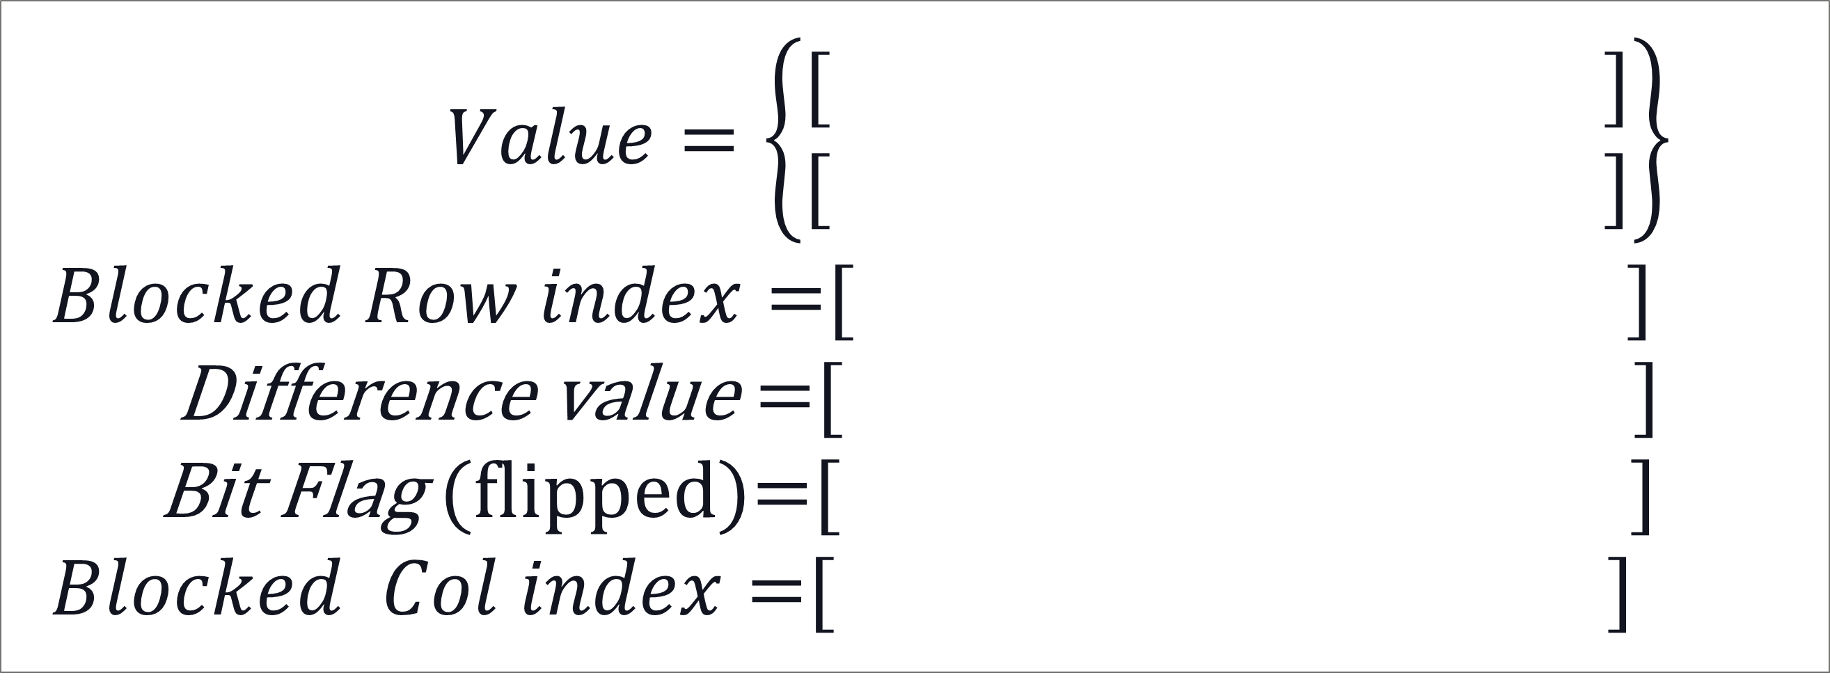
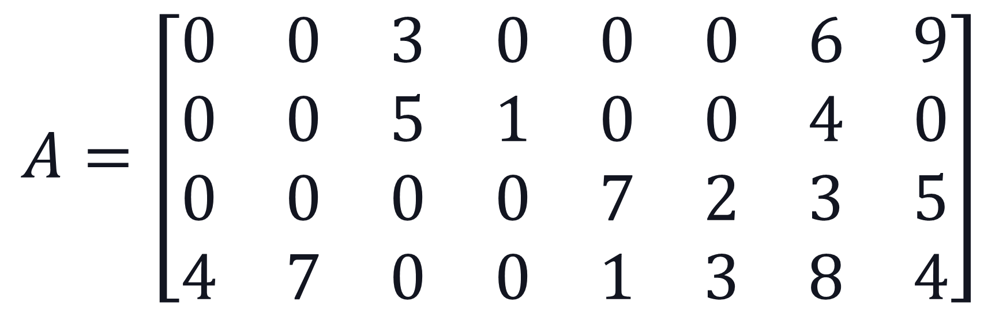
Blocked compressed COO (BCCOO) format
Row Index Compression Ratio: 1/32
$$A=\left[\begin{matrix}0 & 0 & 3 & 0 & 0 & 0 & 6 & 9 \\ 0 & 0 & 5 & 1 & 0 & 0 & 4 & 0 \\ 0 & 0 & 0 & 0 & 7 & 2 & 3 & 5 \\ 4 & 7 & 0 & 0 & 1 & 3 & 8 & 4\end{matrix}\right]$$
Bit
Integer
$$Value=\left\{\begin{aligned}[ ] \\ [ ]\end{aligned}\right\}$$
$Blocked Row index=$[ ]
Difference value =[ ]
Bit Flag (flipped)=[ ]
$Blocked Col index=$[ ]
3 0
5 1
6 9
4 0
0 0
4 7
7 2
1 3
3 5
8 4
0
0
1
1
1
0 1 0 0 1
1 0 1 1 0
1
3
0
2
3
BCCOO format block size 2x2

Slide 20
2. BCCOO+ format
Extensions of BCCOO format
BCCOO+ format
Rearrange the non-zeros blocks.
Relief the irregular access to the vector
Column index compression
Using difference function on the column index.

Slide 21
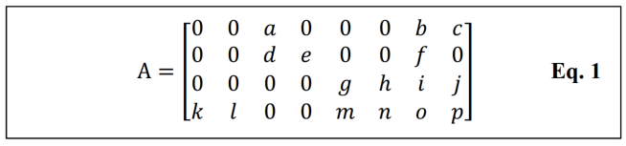
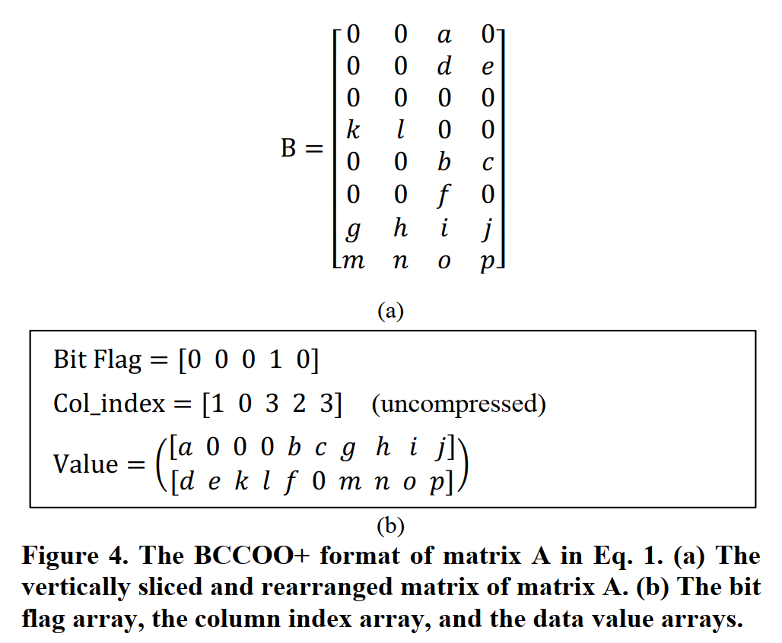
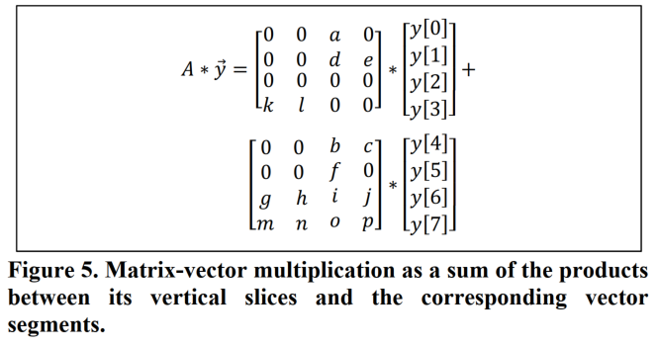
2. BCCOO+ format
提升空间局部性
Col_index使用源矩阵的列，方便确定对应向量元素

Slide 22
2. BCCOO+ format
BCCOO+格式，需要使用临时数组存储中间结果，也需要额外的kernel来合并结果
临时数组的空间占用和划分块有关，可能占用空间较大，影响性能
需要根据硬件平台和格式选择是否使用

Slide 23
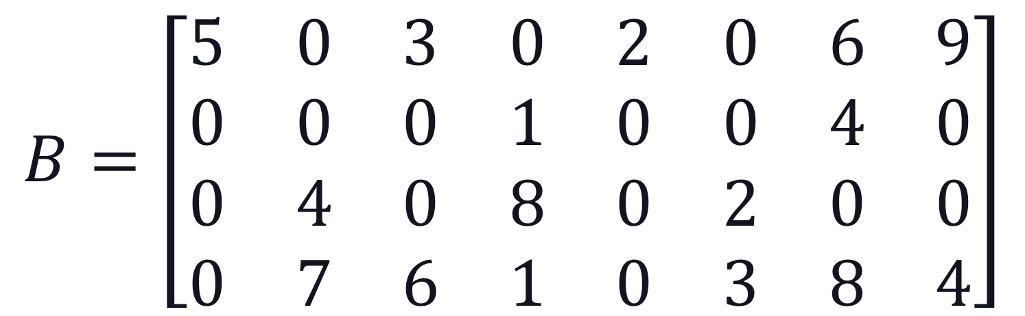

Example matrix
Assume there are 4 threads
$$B=\left[\begin{matrix}5 & 0 & 3 & 0 & 2 & 0 & 6 & 9 \\ 0 & 0 & 0 & 1 & 0 & 0 & 4 & 0 \\ 0 & 4 & 0 & 8 & 0 & 2 & 0 & 0 \\ 0 & 7 & 6 & 1 & 0 & 3 & 8 & 4\end{matrix}\right]$$
$Bit Flag=$[1 1 1 1 0 1 0 1 1 0 1 1 1 1 1 0]
$$Col index=[0 2 4 6 7 3 6 1 3 5 1 2 3 5 6 7]$$
$$Value=[5 3 2 6 9 1 4 4 8 2 7 6 1 3 8 4]$$
BCCOO format of matrix B (Block size 1x1)

Slide 24
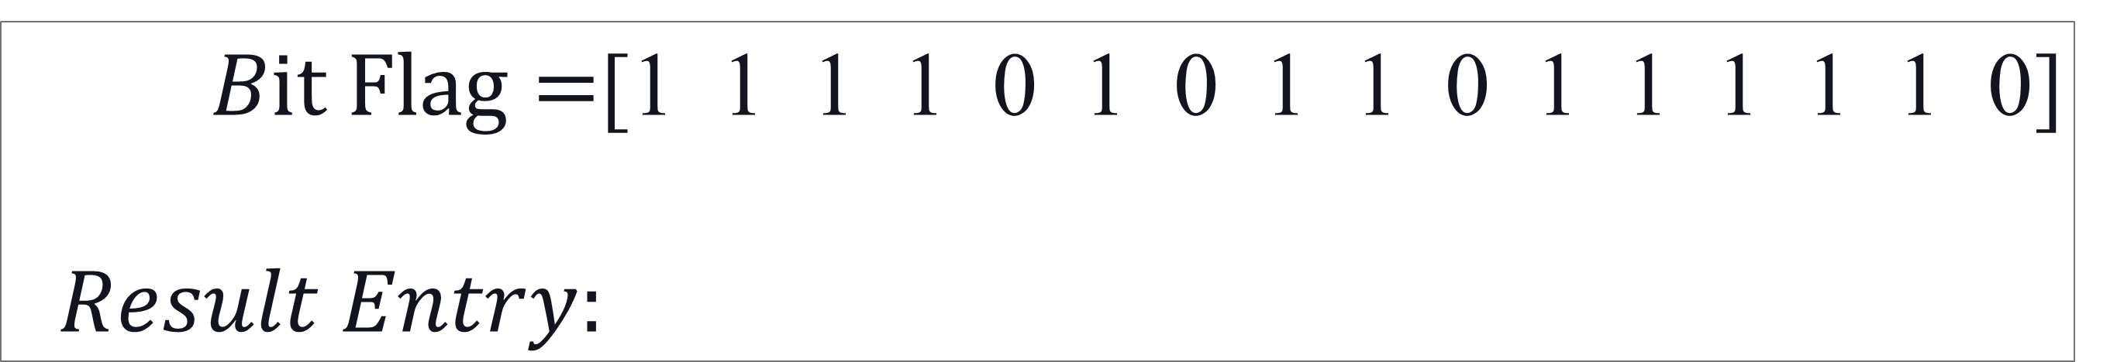
Auxiliary Information for SpMV: Result Entry
Getting the location of the first result generated by each thread in the output array. That’s to say to compute the row index that the first result in each thread belongs to.
Only need to count the zero number in the bit flag array of the previous threads.
$Bit Flag=$[1 1 1 1 0 1 0 1 1 0 1 1 1 1 1 0]
$$Result Entry:$$
0
0
2
3
Thread 0
Thread 1
Thread 2
Thread 3

Slide 25
Even workload partition
3. Efficient Segmented Sum/Scan for SpMV
No workload imbalance
Non-zero Blocks
workgroups
workgroup 0
workgroup 1
workgroup 2
workgroup 3
threads
T0
T1
T2
T3

Slide 26
3. Efficient Segmented Sum/Scan for SpMV
Three logic steps
Read the data and multiply them with the corresponding vector values.
Perform a segmented sum/scan using the bit flag array from our BCCOO/BCCOO+ format
Results combination and write back the results to global memory.
All these three steps are implemented in one kernel

Slide 27
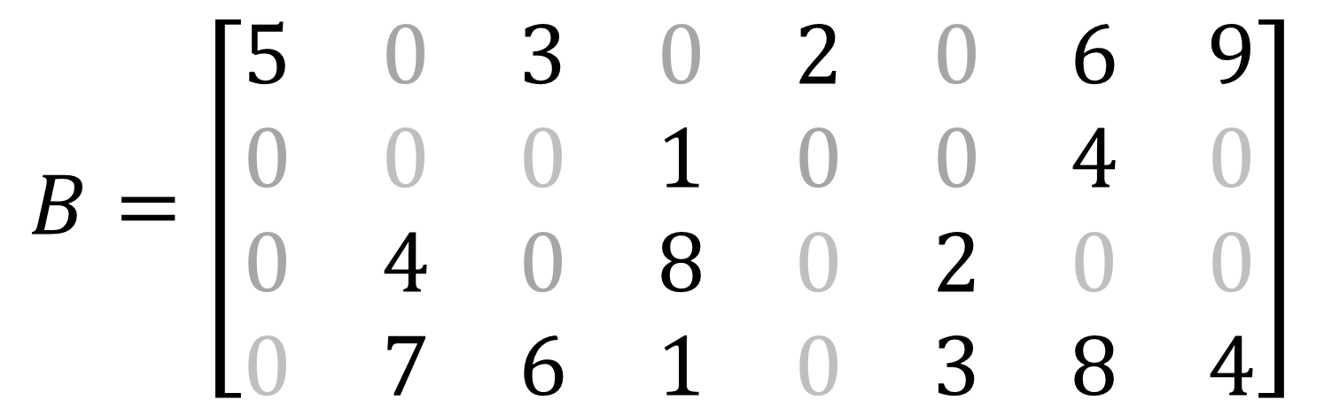
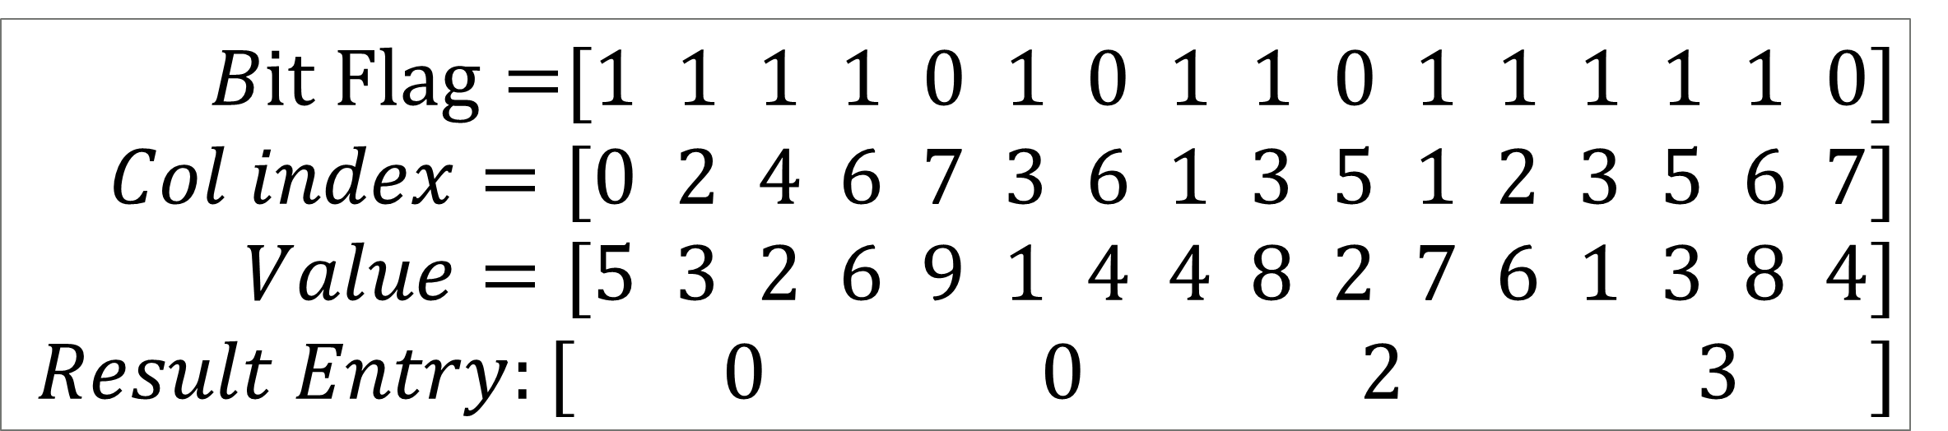
Step 1 : Read the data and multiply with vector values
Ex: 4 Threads
$$B=\left[\begin{matrix}5 & 0 & 3 & 0 & 2 & 0 & 6 & 9 \\ 0 & 0 & 0 & 1 & 0 & 0 & 4 & 0 \\ 0 & 4 & 0 & 8 & 0 & 2 & 0 & 0 \\ 0 & 7 & 6 & 1 & 0 & 3 & 8 & 4\end{matrix}\right]$$
$Bit Flag=$[1 1 1 1 0 1 0 1 1 0 1 1 1 1 1 0]
$$Col index=[0 2 4 6 7 3 6 1 3 5 1 2 3 5 6 7]$$
$$Value=[5 3 2 6 9 1 4 4 8 2 7 6 1 3 8 4]$$
$$Result Entry:[ 0 0 2 3 ]$$
BCCOO format of matrix B

Slide 28
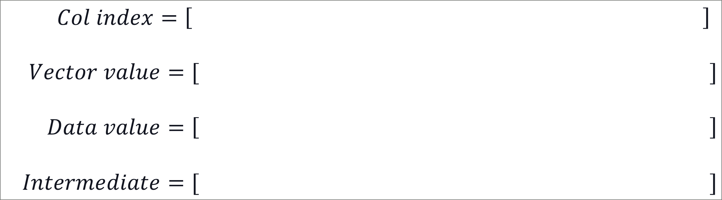
Step 1 : Read the data and multiply with vector values
Ex: 4 Threads
Problem: B*x =?
Assume: x=[2 9 6 5 4 8 7 3]
$$Col index=\left[ \right]$$
$$Vector value=[ ]$$
$$Data value=\left[ \right]$$
$$Intermediate=[ ]$$
0
2
4
6
$$7 3 6 1 3 5 1 2 3 5 6 7$$
2
6
4
7
$$3 5 7 9 5 8 9 6 5 8 7 3$$
X
$$5 3 2 6 9 1 4 4 8 2 7 6 1 3 8 4$$
=
$$10 18 8 42 27 5 28 36 40 16 63 36 5 24 56 12$$

Slide 29
Step 2: Segmented sum/scan
Three types of rows in our algorithm
1. All the non-zeros of the row are in the same thread.
Serial segmented sum/scan in threads
2. A row spans multiple threads.
+ Parallel segmented sum/scan among threads.
3. A row spans multiple workgroups.
+ Cross workgroup synchronization

Slide 30
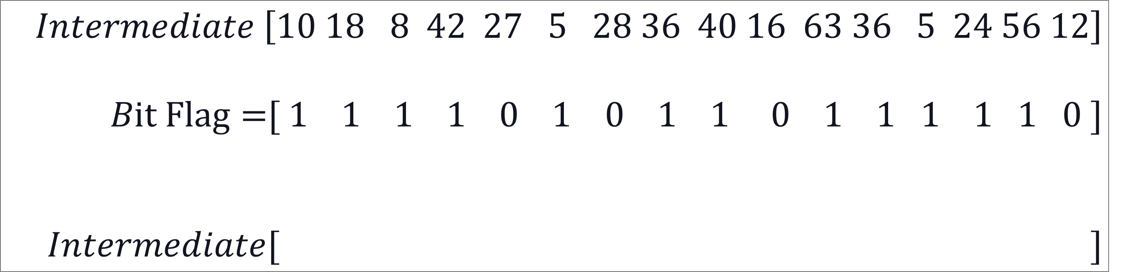

Step 2 ： Segmented sum/scan
1. Serial segmented sum/scan in each thread
Serial Segmented Scan (intermediate[-1]=0):
Intermediate[i] = intermediate[i-1] * BitFlag[i-1] + Intermediate[i]
$$Intermediate \left[10 18 8 42 27 5 28 36 40 16 63 36 5 24 56 12\right]$$
$Bit Flag=$[ 1 1 1 1 0 1 0 1 1 0 1 1 1 1 1 0 ]
$$Intermediate[ ]$$
Scan
Scan
Scan
Scan
$$10 28 36 78$$
$$40 56 63 99 5 29 85 97$$
27
5
33
36

Slide 31
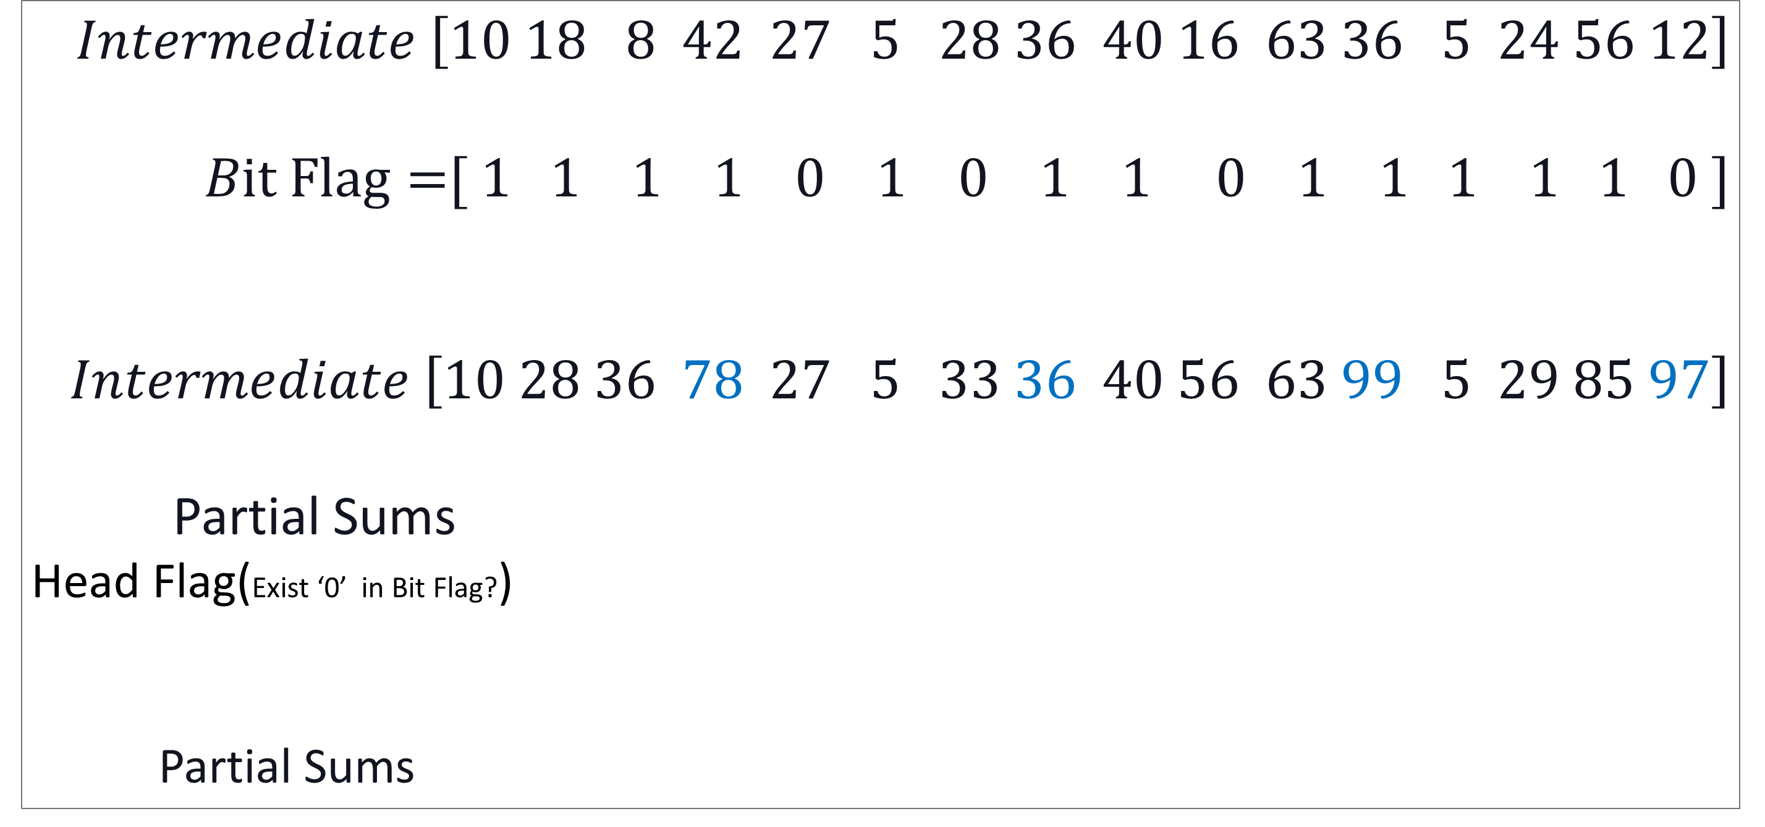
Step 2 ： Segmented sum/scan
2. Generate last partial sum and perform parallel segmented scan among threads for the last partial sum
$$Intermediate \left[10 18 8 42 27 5 28 36 40 16 63 36 5 24 56 12\right]$$
$Bit Flag=$[ 1 1 1 1 0 1 0 1 1 0 1 1 1 1 1 0 ]
$$Intermediate \left[10 28 36 78 27 5 33 36 40 56 63 99 5 29 85 97\right]$$
Partial Sums
Head Flag(Exist ‘0’ in Bit Flag?)
Partial Sums
Scan
Scan
Scan
Scan
78 36 99 0
0
1
1
1
Parallel segmented scan
78 36 99 0

Slide 32
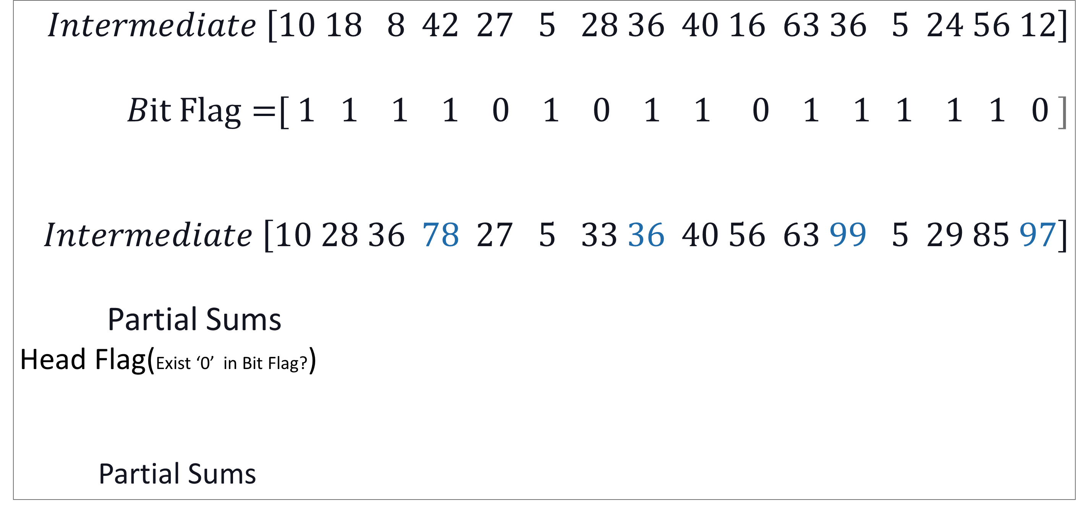
Step 2： Segmented sum/scan
2. Generate last partial sum and perform parallel segmented scan among threads for the last partial sum
$$Intermediate \left[10 18 8 42 27 5 28 36 40 16 63 36 5 24 56 12\right]$$
$Bit Flag=$[ 1 1 1 1 0 1 0 1 1 0 1 1 1 1 1 0 ]
$$Intermediate \left[10 28 36 78 27 5 33 36 40 56 63 99 5 29 85 97\right]$$
Partial Sums
Head Flag(Exist ‘0’ in Bit Flag?)
Partial Sums
1
Scan
Scan
Scan
Scan
78 36 99 0
0
0
1
1
1
Parallel segmented scan
135
78 36 99 0

Slide 33
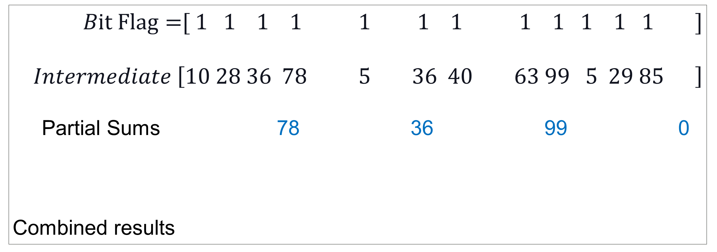
Step 3 ： Results combination and write the results to global memory.
Problem: B*x =?
Assume: x=[2 9 6 5 4 8 7 3]
$Bit Flag=$[ 1 1 1 1 1 1 1 1 1 1 1 1 ]
$$Intermediate \left[10 28 36 78 5 36 40 63 99 5 29 85 \right]$$
Partial Sums 78 36 99 0
Combined results
0
0
0
0
27
33
56
97
+
+
+
105
33
92
196
$$Result Entry 0$$
0
0+1
2
3
$$Final Result [ , , , ]$$
105
33
92
196

Slide 34
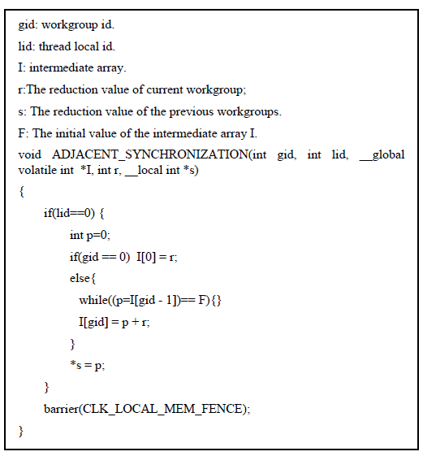
4. Adjacent synchronization for inter-workgroup accumulation
End
Start
Local barrier
lid == 0?
No
Yes
Initialize P to zero
*s=P
gid== 0?
Yes
G[0] = r
No
P = G[gid – 1]
P == init_val?
No
G[gid]= P+ r
Yes

Slide 35
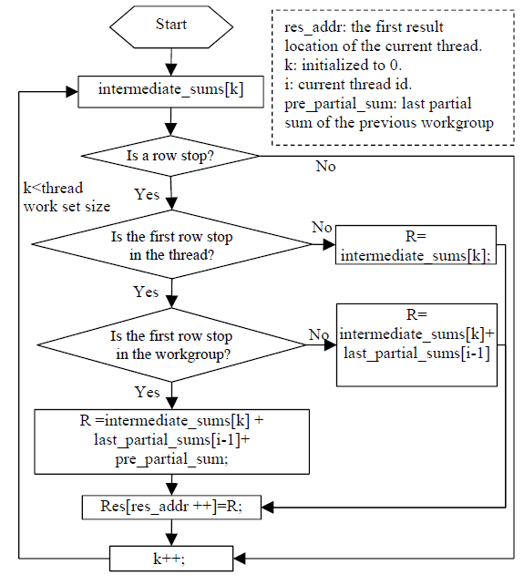
5. Combine the partial sums from threads and groups

Slide 36
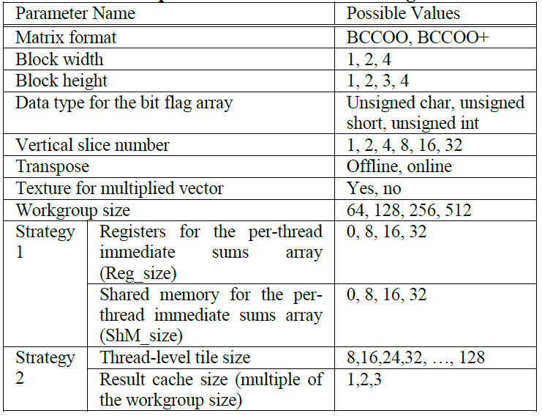
6. Auto-Tuning Framework
In order to generate the optimal kernel code, we employ the auto-tuning technique to search the best parameters.
Tunable parameters

Slide 37
目录
引入
1
v
论文介绍
2
论文结果
3
论文总结
4

Slide 38
Experiments
Experimental Methodology
We have implemented our proposed scheme in OpenCL.
We have evaluated our scheme on GTX 680 using 20 real world matrices.
Comparison library
CUSPARSE V5.0 (Nvidia official SpMV library)
CUSP (SC 09)
clSpMV (ICS 12)

Slide 39
Name | Size | Non-zeros (NNZ) | NNZ/Row
Dense | 2K * 2K | 4M | 2000
Protein | 36K * 36K | 4.3M | 119
FEM/Spheres | 83K * 83K | 6M | 72
FEM/Cantilever | 62K * 62K | 4M | 65
Wind Tunnel | 218K*218K | 11M | 53
FEM/Harbor | 47K * 47K | 2.3M | 59
QCD | 49K * 49K | 1.9M | 39
FEM/Ship | 141K*141K | 7.8M | 28
Economics | 207K*207K | 1.2M | 6
Epidemiology | 526K*526K | 2.1M | 4
FEM/Accelerator | 121K*121K | 2.6M | 22
Circuit | 171K*171K | 0.95M | 6
Webbase | 1M * 1M | 3.1M | 3
LP | 4K * 1.1M | 11.3M | 2825
Circuit5M | 5.56M* 5.56M | 59.5M | 11
eu-2005 | 863K*863K | 19.2M | 22
Ga41As41H72 | 268K*268K | 18.4M | 67
in-2004 | 1.38M* 1.38M | 17M | 12
mip1 | 66K * 66K | 10.3M | 152
Si41Ge41H72 | 186K*186K | 15M | 81
Used Matrices

Slide 40
GFLOPS
Performance results on Kepler (GTX 680)

Slide 41
GFLOPS
Performance results on Kepler (GTX 680)

Slide 42
GFLOPS
Performance results on Kepler (GTX 680)

Slide 43
GFLOPS
Performance results on Kepler (GTX 680)

Slide 44
GFLOPS
Average Performance Improvement:
65% over CUSPARSE, 70% over clSpMV COCKTAIL,
88% over clSpMV best single, 150% over CUSP
Performance results on Kepler (GTX 680)

Slide 45
目录
引入
1
v
论文介绍
2
论文结果
3
论文总结
4

Slide 46
Conclusions
The BCCOO format
Addressed the memory bandwidth problem
The customized matrix-based segmented sum/scan algorithms
Addressed the work load imbalance problem
Only need to invoke one kernel.
Very efficient: used a lot of optimization approaches.
Results (GTX 680)
Vs. CUSPARSE V5.0
up to 229% and 65% on average improvement
Vs. clSpMV
up to 195% and 70% on average improvement

Slide 47
Thank you

